Slide 1

2024
BUDGET
PROPOSAL

Slide 2
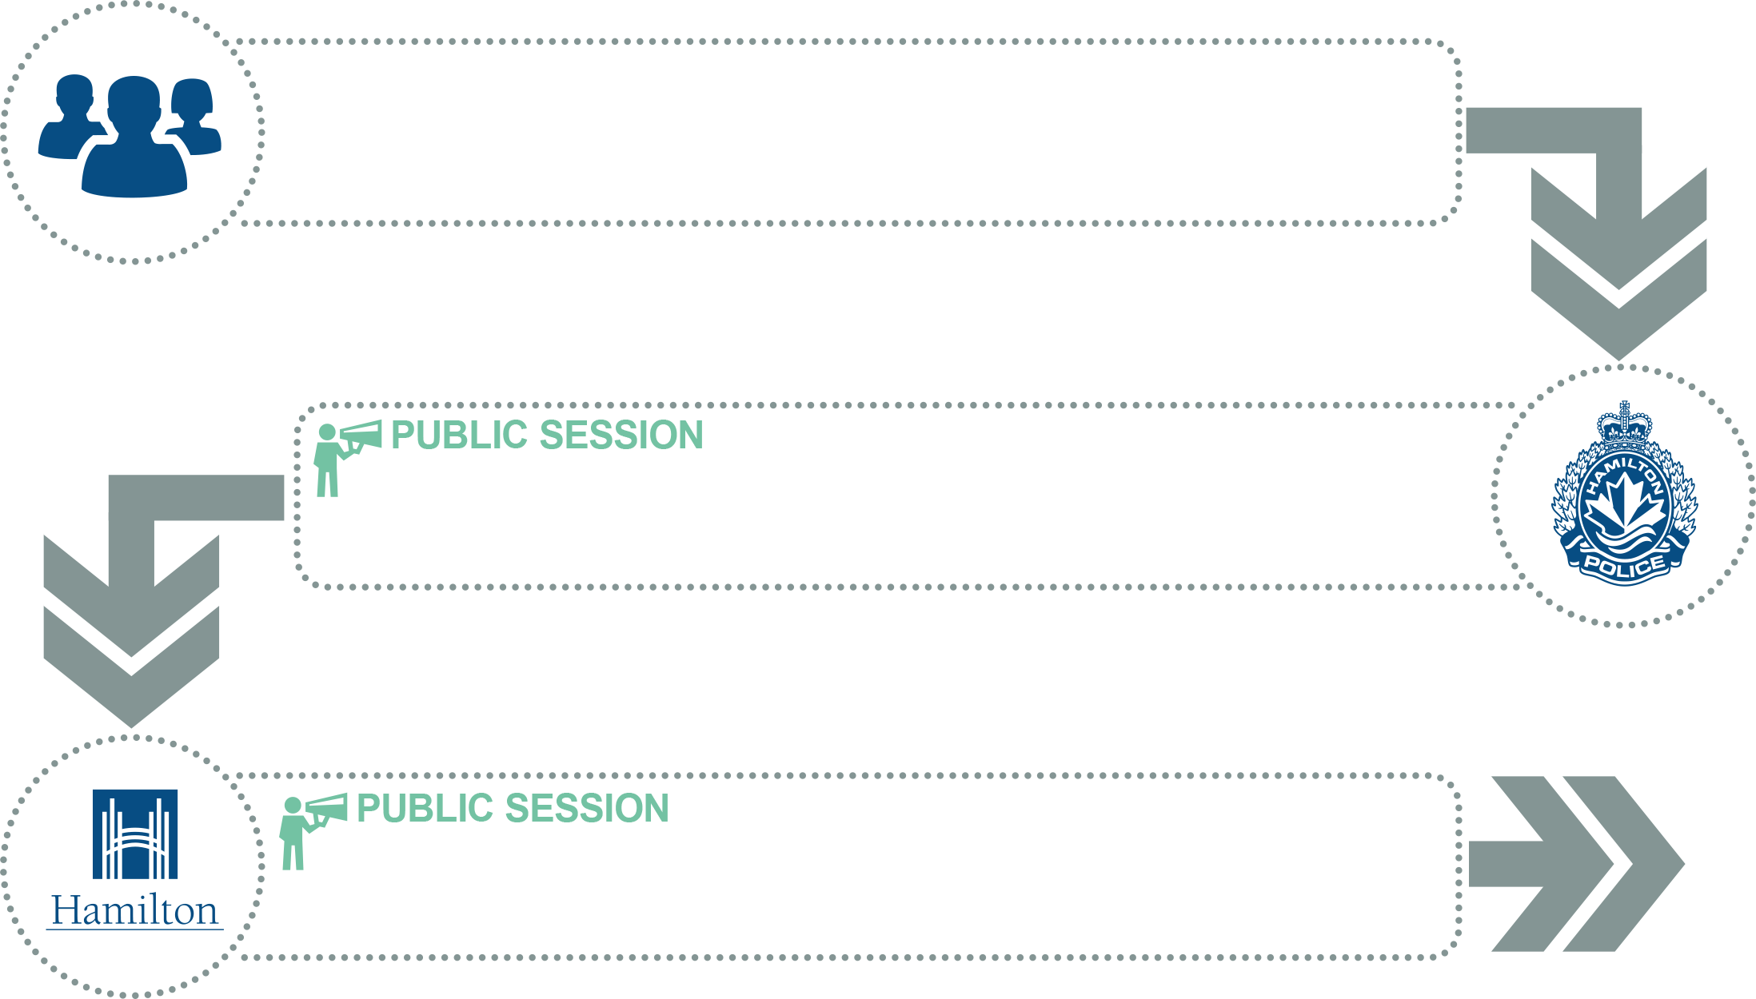
ANNUAL BUDGET PROCESS
HAMILTON POLICE SERVICE BOARD BUDGET COMMITTEE
HAMILTON POLICE SERVICE BOARD
HAMILTON CITY COUNCIL

Slide 3





2023-2026 STRATEGIC DIRECTIONS
Community Safety
Collaborative Engagement
Culture and Capacity
Core Assets
Trusting Change

Slide 4
BUDGET REQUEST
Hamilton Police Service Budget Request
Operating*
6.25%
Capital*
0.63%
6.88%

Slide 5
2024 BUDGET PRESSURES
0.70%
0.27%
TOTAL PRESSURE
6.88%
5.92%
4
Notes:
Add in total operating pressures

Slide 6

Policing Hamilton at a Glance

Slide 7

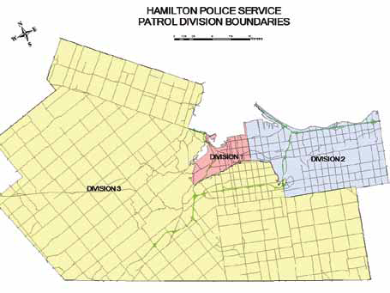


POLICING OUR COMMUNITY
Authorized Strength
592,000
Population
868
349
Sworn
Civilian Positions
245,175
Households
112,710
Area
hectares
Source (City Demographics): Municipal Financial Information Report (FIR 2022)
Source (Authorized Strength): Internal numbers

Slide 8
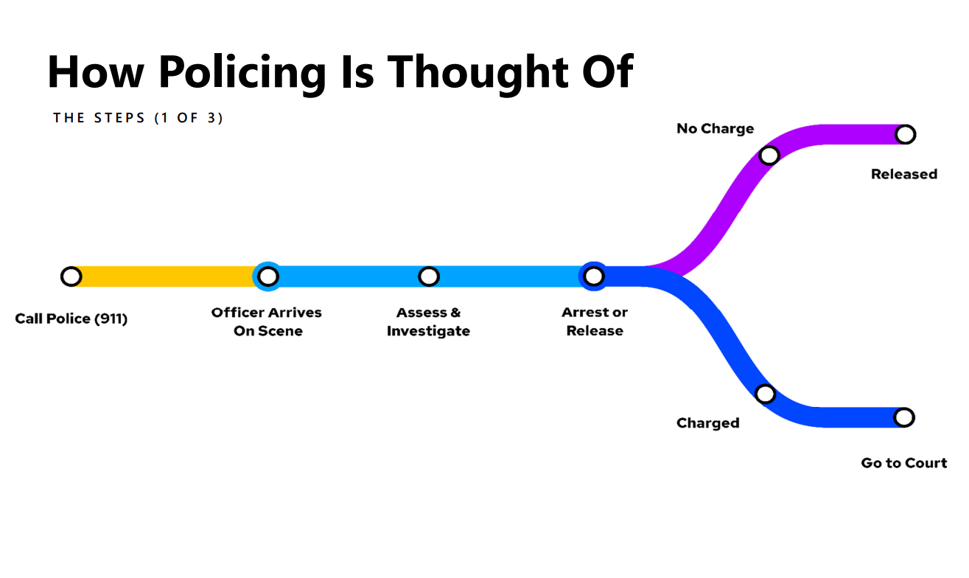
HOW POLICING IS THOUGHT OF

Slide 9
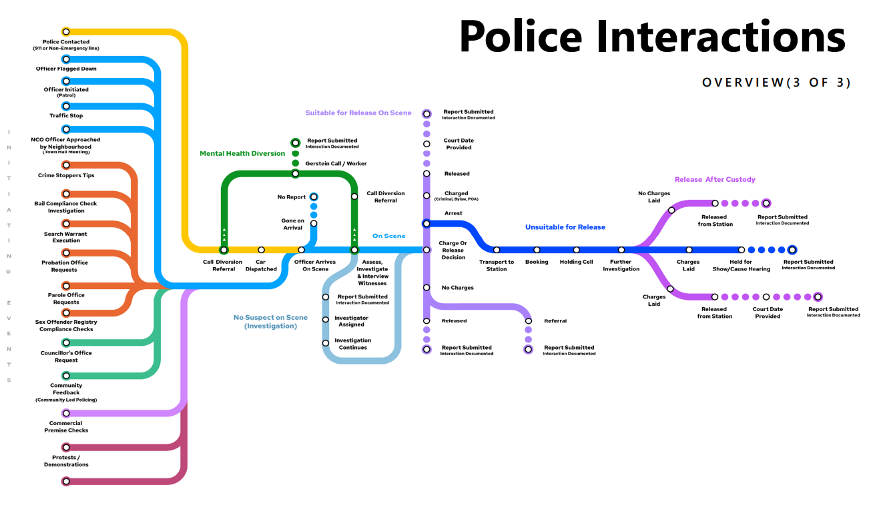
POLICING COMPLEXITY

Slide 10




PUBLIC SAFETY ACCESS POINT (PSAP)
Total Calls Received*
15.1%
INCREASE OVER 5 YEARS
446,759
258,354
26.2%
911 Calls
Received
INCREASE OVER 5 YEARS
188,405
Non Emergency Calls Received
2.8%
INCREASE OVER 5 YEARS
Dispatched for Service (HPS)
-8.1%
DECREASE OVER 5 YEARS
94,153
*2023 Projected PSAP calls includes police, fire and ambulance
Notes:
* Add a note for projected and does not include traffic

Slide 11

DISPATCH TIMES
Priority
0
HIGHEST PRIORITY
Immediate Response Required
Priority
1
IN PROGRESS
EVENTS
Domestic
Suicide / Person
in Crisis
Disturbance
on Premise
Priority
2
JUST OCCURED
EVENTS
Suspicious Activity
Driving Complaints
Disturbance on Premise
Priority
3
REPORT
EVENTS
Trespassing
Residence / Compassion
Disorderly
Priority
4
REPORT
EVENTS
Noise Complaints
Break and Enter Report
Neighbour Trouble
Dispatch
Time:
00:01:03
00:03:05
00:13:72
01:04:98
01:29:84
FROM 2022
FROM 2022
FROM 2022
FROM 2022
FROM 2022
Target: 30 sec
Target: 3 min
Target: 15 min
Target: 60 min
Target: 180 min
Notes:
Is this an average?

Slide 12

CALL INTAKE
INTAKE - PSAP
TRIAGE
HPS SERVICE
EMS
FIRE
CALL
ASSIST
911
Non-Emergency
OFFICER
RESPONSE
TOTAL CALLS 446,759
86,432
X
RESOLVED
121,190
INTAKE - OTHER
HPS
COMMUNICATIONS
(PSAP)
ARO ONLY
7,721
WALK-IN
ONLINE
RESPONSE TO
ONLINE
10,340
POLICE RESPONSE
TOTAL OTHER 19,770
TOTAL RESPONSES 102,173
Notes:
Walk-in – 6,656
Online – 13,114
911-ADV = 121,980 (2022 - 90,084)
EMS 2023 Proj. Adv = 63,135 (2022 - 62,451)
Fire 2023 Proj. Adv = 4,237 (2022 - 3,806)
OPP Adv Proj. Adv = 6,591 (2022 - 5776)

Slide 13







COMPLEXITY OF A ‘CALL’
TOTAL: 65
PATROL: 51
CRIMINAL INVESTIGATION
DIVISION: 4
SPECIAL CONSTABLES: 5
FORENSICS ASSISTANT: 1
FORENSICS SPECIAL
CONSTABLES: 2
DUTY OFFICER: 1
EXPLOSIVE DISPOSAL UNIT: 1
DAY 2
DAY 4
DAY 6
Police investigate subject’s residence* and find evidence.
Officers continue to guard subject at hospital
Review video and
arrest subject
Search warrant executed at subject’s business*
Search warrant executed at subject’s residence with Explosive Disposal Unit
Search warrant executed on two cars
DAY 1
DAY 3
DAY 5
DAY 7
Call comes in for reports of a subject with a gunshot wound at a local hospital
Officers guard victim at hospital
Officers attend subject’s address believed to be scene
Retrieve video from an address near subject’s business
Remove property from subject’s residence
*Officers required to hold scenes for the duration of the investigation

Slide 14
TOTAL COMMUNITY DEMAND
67%
67%
67%
66%
66%
65%
62%
64%
Total Community Demand = CAD Events Created (excl. advised events, interagency not requiring HPS, and admin codes) + Online Reports
Total Responded Events = HPS Call for Service 2023 Definition + Online Reports
Notes:
Asset Management
Trying to find the methodology & align data to support appropriate management of community demand

Slide 15






MOST FREQUENT CALL TYPES
2.0%
2023 YTD
4,892
2.4%
2023 YTD
2.216
10.0%
2023 YTD
4,416
26.5%
2023 YTD
2,934
4.5%
2023 YTD
8,314
Ambulance
Assist
Break &
Enters
Motor Vehicle Collisions
Partner/Family Violence
Person
In Crisis
7.7%
2023 YTD
2,442
9.8%
2023 YTD
8,504
7.0%
2023 YTD
6,091
Road
Safety
Suspicious
Activity
Trespassing
Notes:
Add the total volume in these slides

Slide 16
FRONTLINE REALITIES
27.0%
2023 YTD
17.6%
2023 YTD
25.7%
2023 YTD
0%
2023 YTD
10
33
20
273
Homicide
Victims
Shooting
Occurrences
Shooting
Victims
Guns
Seized
13%
2023 YTD
4.9%
2023 YTD
14.0%
2023 YTD
14
64
1,404
MVC Fatal Victims
Hate Crime
Victims
Auto
Thefts
Notes:
Online Reporting is up 20% (from 14 to 29) – Hate Occurrences are down
Seized gun as of October 31st, 2023
Homicides as of December 13th 2023
Shootings as of December 13th, 2023

Slide 17
INVESTMENT IN POLICING AND
IMPACT ON CRIME RATE
BETTER

Slide 18

BENCHMARKING – BIG 12
Officers per 100,000 Population
Hamilton ranks 6th on the 2022 Violent Crime Severity Index.
For HPS to rank 6th in officers per 100,000 population, we would require:
13
more officers
Source: Stats Canada 35-10-0077-01 & Municipal Financial Information Report (FIR 2022)
Notes:
Hamilton is 6 officers below the median: [[592,000/ 100,000] * 146.9 ] - [592,000 / 100,000] * 146.6]]
If Hamilton matched the 6th highest officers per 100,000 – Hamilton would require 13 more officers [871 - 858]

Slide 19
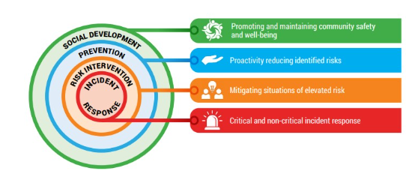
CSWB – HPS ALIGNMENT
RIST
26.5%
2023 YTD
2,934
MCRRT
SNP
Person
In Crisis
COAST
PATROL RESPONSE
1997
2011
2013
2022
CSWB = Community Safety and Well-being Plan

Slide 20
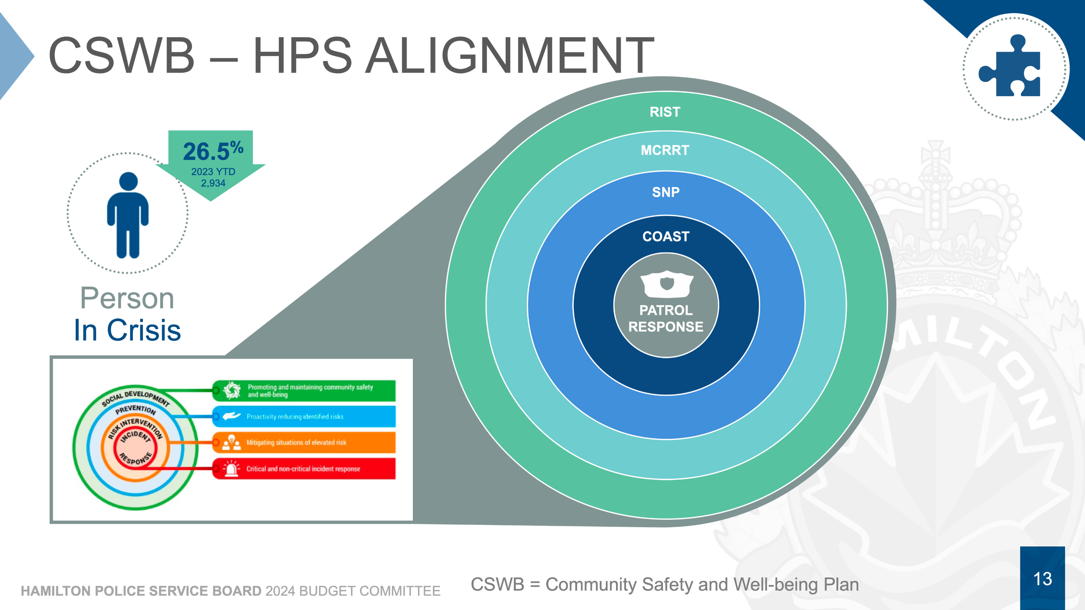

Slide 21
WORKLOAD EFFICIENCIES
Officer Hours Saved:
5,116 hrs (ARO Diversions)
+ 1,371 hrs (Noise Complaints)
+ 6,194 hrs (Online Reports)
+ 760 hrs (CRC Reporting)
13,441hours
Full Time Employee Savings:
13,441 hours
÷ 1,456 FTE hours per year
9.2 FTE

Slide 22
2024 BUDGET PRESSURES
Sustaining Core Services
  Represents human resource costs
Legislative Requirements
  New regulations from the Community Safety and Policing Act
  NG911
City of Hamilton (COH) Cost Allocations
  Additional budgetary pressures from higher WSIB costs
Technology Requirements
  DEMS
  Software Licenses
  Connected Officer

Slide 23







2024 BUDGET PRESSURES
Supporting the Strategic Plan
Costs and resources for moving the 2023-2026 Strategic Plan forward
Inquest Recommendation
Missing Person Unit to fulfill recommendations from Gloria Epstein inquiry and Devon Freeman inquest
Community Safety
Crime Analyst Supervisor
Collaborative Engagement
Corporate Communications Coordinator
Core Assets
Automotive Technician/Upfitter
Court Document Clerks
Financial Analyst
Niche Trainer

Slide 24
BUDGET ASK
$9.24M
Sustaining Core Services
$0.44M
Legislative Requirements
$1.06M
City of Hamilton Cost Allocations
$13.32M
+6.88%
$0.96M
Technology Requirements
$0.54M
Supporting the Strategic Plan
$0.14M
Inquest Recommendations
$0.94M
Other

Slide 25

PSA SECTION 4(3) ITEMS
$6.51M
Section 4(3) states that the municipality has the legislative responsibility for providing all the infrastructure and administration necessary, including vehicles, boats, equipment, communications devices, buildings and supplies.

Slide 26

Crime Prevention
Law Enforcement
CORE POLICING
Maintaining the Public Peace
Emergency Response
Any Other Prescribed Policing Functions
Assistance to Victims of Crime

Slide 27
2024 BUDGET
Section 4(3) Items
3.05%
Capital Expenditure
2.25%
$6.50
MILLION
Salary/Wages/Benefits
85.54%
$4.79 MILLION
Total Net Budget
$213.42
MILLION
$182.56
MILLION
$19.57 MILLION
Operating Expenditure
9.17%
*Anomalies due to rounding

Slide 28
RECOMMENDATION
Hamilton Police Service Board approve
the 2024 Budget of
6.88%
Approve PSA Section 4(3) budget items, representing a 3.36% increase subject to a reduction for all such items included in the City of Hamilton’s 2024 Target Tax.

Slide 29

OUTCOMES FROM BUDGET APPROVAL
Increased Community Safety
Enhanced Collaborative Engagement
Improved Culture and Capacity
Modernized Core Assets
Creating Trusting Change

Slide 30
QUESTIONS?

